Slide 1
Data 824 HW7: Orders Workbook
Chad Huntebrinker, created on 10/15/2025

Slide 2
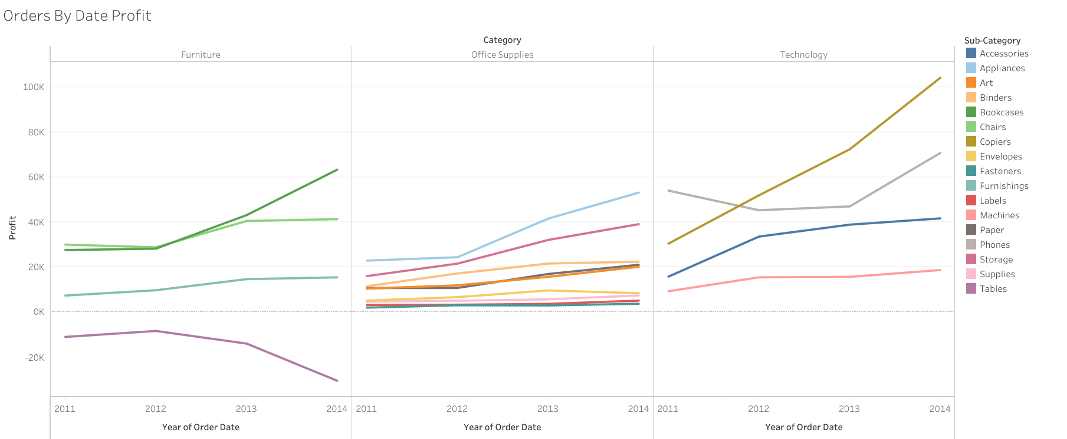
We see that all of the sub-categories tend to go up with time, except for tables

Slide 3
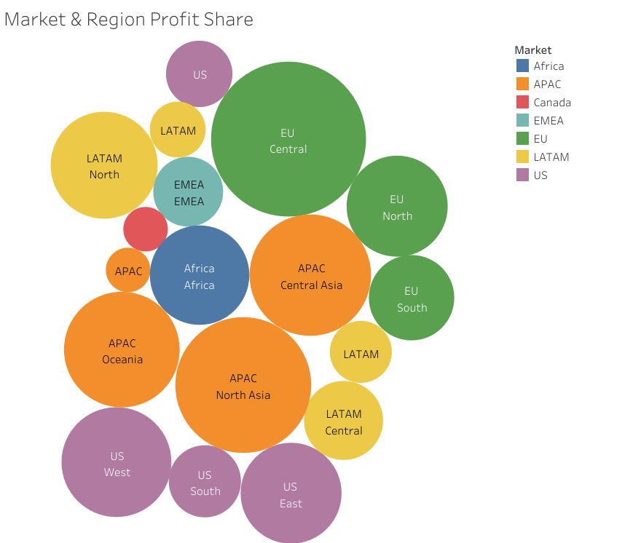
EU and APAC have the biggest profit share
Canada has the smallest

Slide 4
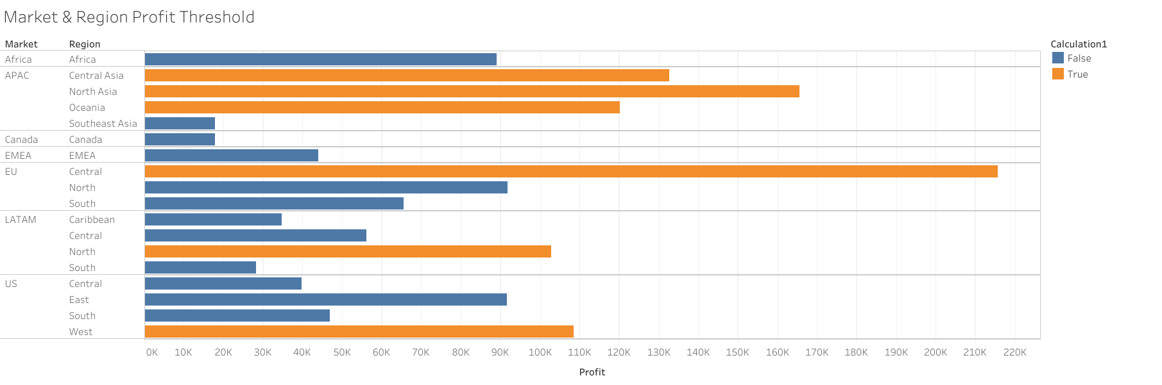
Check to see what Market and Regions have Profits over $100,000
APAC - Central Asia
APAC - North Asia
APAC – Oceania
EU – Central
LATAM – North
US – West

Slide 5
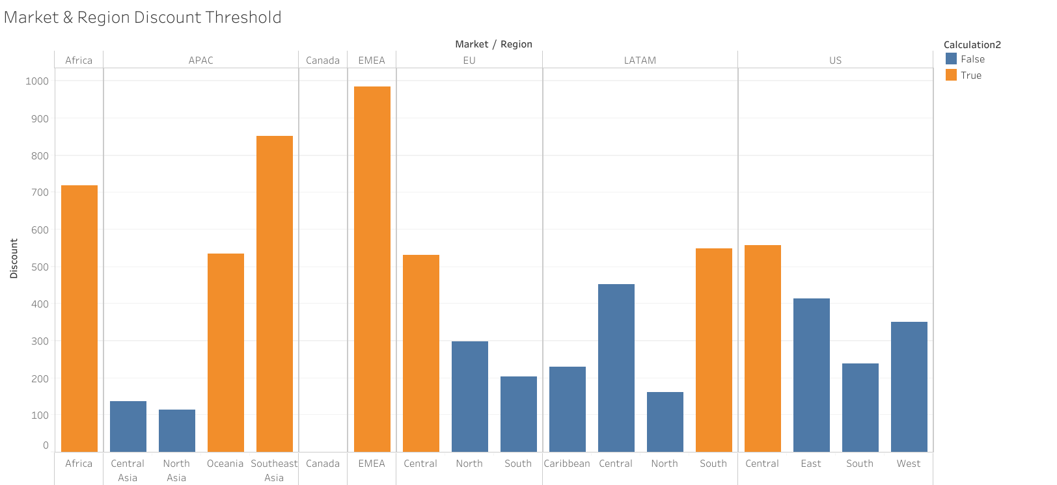
See that Profit isn’t always correlated with Discount
Market and Regions with a Discount over 500 and had a Profit over $100,000
  APAC – Oceania
Market and Regions with a Discount over 500 and had a Profit under $100,000
  AFRICA – Africa
  APAC – Southeast Asia
  EMEA – EMEA
  EU – Central
  LATAM – South
  US – Central

